Slide 1


Re-Evaluating YouTube Radical Content Pathways
Mika Desblancs

Slide 2
Table of contents
Introduction
Initialization
Login and history deletion
Video feature extraction
Recommendations and tree building
Termination and tree saving
Data analysis

Slide 3
Introduction:
Goal:
To study the “rabbit-hole effect” of the YouTube recommendation system]
To analyze the type of political content suggested by the algorithm
Collect data to determine whether there is any bias in the recommendation system
Libraries:
Selenium: used to interact with webpages as well as chrome tabs and windows and locating elements in a tab
Asyncio: library to run concurrent code so that different commands can be run in parallel or paused
Anytree: implements a tree data structure where each node has four features (id, parent, video and title)

Slide 4
2. Initialization
Input:
Text file containing a list of seed URLs separated by a newline “\n”
Object
Category
url_seed
Max_wait
Username
Password
Num_reco
Depth
Videos_parallele
Trial_id

Slide 5
3.1.Login
Accept the Google prompt about cookie tracking. There are two different types of messages so my code accounts for both
Enter the username sending each letter spaced out according to a Gaussian distribution with mean 1 and standard deviation 3 to avoid bot detection
Passing the Captcha security check (requires user input)
Enter the password in the same way as the username with the same procedure as the username
Bypassing the second security check: phone or email code verification (requires user input for code location and code numbers)
Checking that we are in fact logged in by looking for the “Notifications” button
N.B. I Iogin before every pass of my algorithm in order to speed up the video scraping process.

Slide 6
3.2.History deletion
Go to the MyActivity page from which we can delete the YouTube history
Find the button which prompts the delete user history panel
Click on the delete user history with “All time” option
Click on the confirm button and close the tab
If the confirm button is not present, then it means we got the message indicating there is no video history and thus nothing to delete. My script will print “No history to delete” and close the tab

Slide 7
4. Video feature extraction (1)
Accept the data protection button (if it appears)
Skip ads
Look for a CSS selector which indicates how many ads are going to be played; if that number is over 0 then there are ads to be watched
Search & click on the “Skip-ad” button every 5 seconds until there are no ads to be watched; 5 seconds is the typical time you need to wait until you can skip
Use Selenium find_element_by_xpath/css() method to extract all the relevant information
Wait a number of seconds equal to min(video length, 180 seconds); and open other videos while I wait for this video to be watched. This is done by passing function control back to the event loop, suspending execution until the video is watched

Slide 8
5. Recommendations and tree building (1)
RECOMMENDATIONs:
Find the parent node with its URL
Find the URL of recommended videos using the “href” attribute
Check whether the video URL is not already in the tree nor in the recommended videos array
Add a node with parent the currently visited node and id the URL; since these videos have not been saved yet I had them with “video” feature and “title” empty
Append the recommended video URLs to the list of URLs that need to be visited

Slide 9
5. Recommendations and tree building (2)
TREE BUILDING
Add recommended video nodes to the tree with the correct parent
Append those URLs to the queue of videos to be watched
The videos_handling() method will add a tuple to an array for each video that was dequeued; the tuple contains the video dictionary and the array of recommended videos
For each video, its URL is found again in the tree and video + title modified, and recommended videos appended to the queue

Slide 10
6. Termination and tree saving
Termination happens once the proper number of videos is watched where the proper number of videos is watched
Trees are saved into JSON dictionaries of parent nodes and children

Slide 11
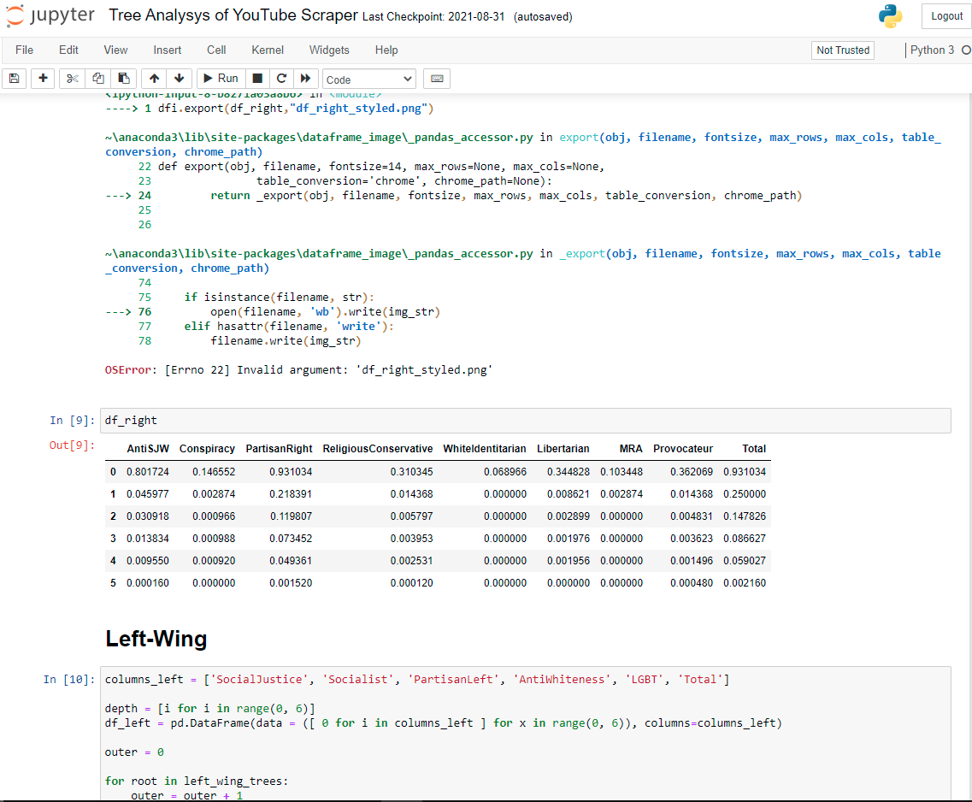
7. Data analysis (Jupyter Notebook)

